Slide 1

The Nature and Economic Role of Money
Exploring money's fundamental functions and its critical role in modern economies.

Slide 2

Three Core Functions of Money
Unit of Account
Medium of Exchange
Store of Value
A measure of value for all goods, services, and assets in the economy.
A means of payment that facilitates transactions between parties.
An asset that maintains purchasing power over time.
These interconnected functions form the foundation of monetary economics and enable modern market economies to function efficiently.

Slide 3

Unit of Account: Simplifying Economic Measurement
Without Money
With Money
For n goods, you need (1/2)n(n-1) exchange ratios.
Only n money prices needed.
For 700 goods, just 700 prices to track.
With 700 goods (CPI categories), that's 245,000 different ratios to track.
Relative prices can be calculated from monetary prices: PA/PB gives the exchange ratio.
Imagine calculating every possible exchange between apples, bananas, cabbages, and hundreds of other items!

Slide 4



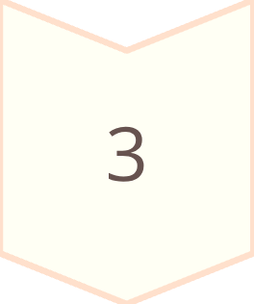
Medium of Exchange: Solving the Double Coincidence Problem
Barter requires a double coincidence of wants – finding someone who has what you want and wants what you have.
Costly Search
Finding the right trading partner takes time and resources.
Trading Posts
Without money: (1/2)n(n-1) specialized posts needed for n goods.
Money Solution
With money: only one shop per commodity required.

Slide 5




The Misaligned Preferences Problem
Three traders with different endowments and preferences illustrate why barter fails even when trades would benefit everyone.
Ina
Has: 6 Bananas
Wants: 1 Cabbage
Harriet
Has: 3 Apples
Wants: 6 Bananas
Jamal
Has: 1 Cabbage
Wants: 3 Apples
No bilateral trade works! But with money as an intermediary, all three can achieve their desired outcomes through sequential exchanges.

Slide 6

Store of Value and Liquidity
Money serves as a store of value during the gap between sales and purchases.
01
While other assets offer rewards (interest, dividends, appreciation), money provides liquidity – the ease of exchange.
Marketability
Ease of sale, high demand
02
Predictability
Stable exchange value
03
Reversibility
No gap between buy/sell value
04
Divisibility
Exchangeable in small units

Slide 7
What Makes an Object Suitable as Money?
Transportability
Durability
Easy to move and carry for transactions.
Maintains physical integrity over time.
Divisibility
Universal Appeal
Can be broken into smaller units without losing value.
Acceptable to all parties in transactions.
Modern money is intrinsically worthless but meets all objective criteria. Central banks create it specifically to fulfill money's three roles.

Slide 8
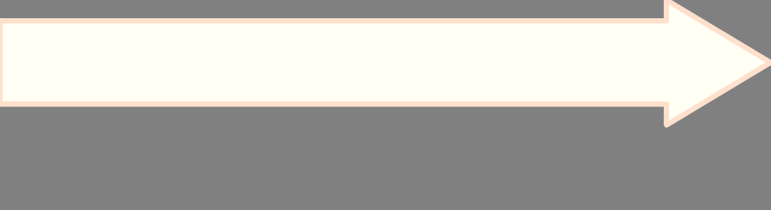

Monetary Aggregates
M2: Broad Money
M1: Narrow Money
M0: Base Money
M1 plus savings deposits – less liquid, offers more rewards
M0 plus demand deposits – conventional definition of money
Coins and paper currency – most liquid, most "money-like"
As we move to higher aggregates, liquidity decreases while pecuniary rewards increase. The line between "money" and "non-money" remains debated among economists.

Slide 9

Keynes Versus the Classical School
Keynesian View
Classical View
Money's macroeconomic importance stems from its role as a store of value.
Focused on money as medium of exchange and unit of account.
Liquidity demand creates spillover effects into markets for other assets and goods.
Downplayed spillover effects to other markets.
Viewed money as a "veil" – important on surface but not affecting real activity.
Greater desire for liquidity can reduce demand for assets and goods, affecting real economic activity.

Slide 10
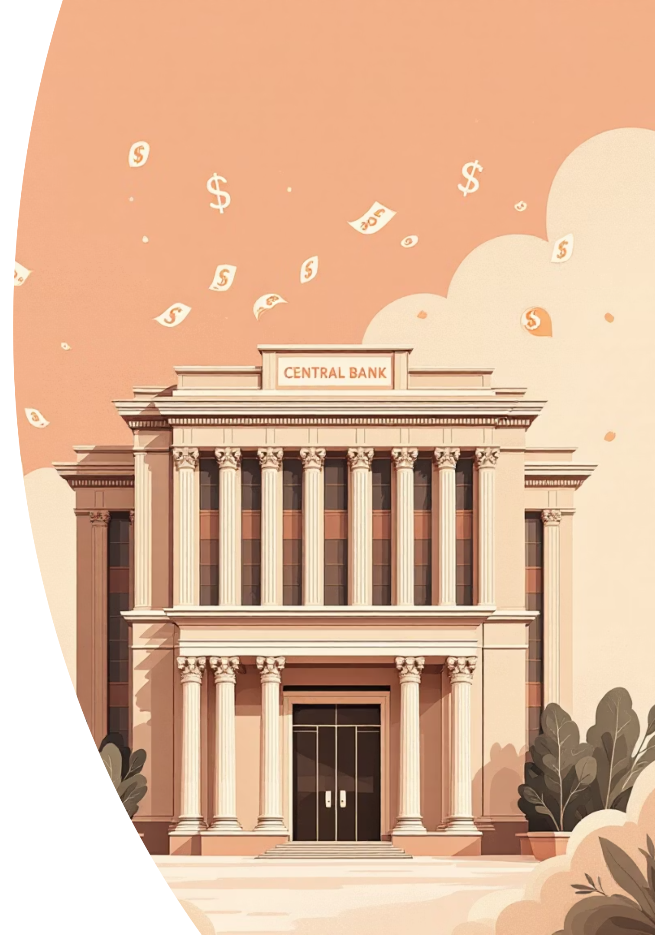
The Quantity of Money Debate
In money's first two roles (unit of account and medium of exchange), the exact quantity seems unimportant. But in macroeconomic debates, money supply levels play a central role.
Classical Irrelevance
Keynesian Significance
The amount of money doesn't affect real economic outcomes – only nominal values change.
Money quantity matters because liquidity preferences affect real economic activity through spillover effects.
Ongoing Debate
These divergent views continue to shape modern monetary policy discussions and macroeconomic theory.

